Slide 1


22CSP72 – PROJECT WORK II PHASE I
EXPLAINABLE MULTIMODAL PARKINSON’S DISEASE DETECTION AND SEVERITY PREDICTION
DONE BY,
23CSR149 NITHEESH S
23CSR174 REDHANI T V
23CSR184 SABARISH K S
SUPERVISED BY,
Ms.NANTHIYA
1

Slide 2
PROBLEM DEFINITION
Parkinson's Disease (PD) is a progressive neurological disorder affecting movement, speech and daily activities.
Current diagnosis mainly depends on clinical examination and specialist experience.
Disease severity changes over time and requires continuous monitoring.
Existing prediction models mainly detect Parkinson's disease but do not accurately predict severity levels.
There is a need for an accurate, explainable and automated severity prediction system.
OBJECTIVES
Predict Parkinson's disease severity using voice-based clinical features.
Select the most important features using Praat Feature Importance.
Train an XGBoost model for severity prediction.
Improve prediction accuracy while reducing unnecessary features.
Use SHAP Explainable AI to explain the prediction made by the model.
Generate an interpretable severity prediction system for clinicians.
2

Slide 3
LITERATURE SURVEY
Paper | Summary | Research Gap
Ensemble Machine Learning Approach for Parkinson's Disease Detection Using Speech Signals (Mathematics, 2024) | Uses speech features with AdaBoost. Applies PCA and SMOTE. Achieves 96% accuracy in Parkinson detection. | Detects only Parkinson's disease, not severity. No clinical severity prediction. Uses AdaBoost instead of XGBoost.
Early Detection of Parkinson's Disease Using Machine Learning (Procedia Computer Science, 2023) | Compares Random Forest, SVM, Logistic Regression and KNN using voice features. Random Forest achieved 91.83% accuracy. | Focuses only on disease detection. Does not estimate UPDRS severity or provide explainability.
Interpretable Machine Learning Framework for Parkinson's Disease Prediction (PLOS ONE, 2025) | Uses SMOTE, feature engineering and SHAP explainability. Compares multiple ML algorithms. | Predicts disease presence only. Does not perform severity prediction using Motor UPDRS or Total UPDRS regression/classification.

Slide 4
RESEARCH GAPS IDENTIFIED
After reviewing previous studies, the following gaps were identified:
Most research focuses only on Parkinson's disease detection.
Very few models predict disease severity.
Many models use all available features, increasing computational cost.
Limited use of feature selection techniques for severity prediction.
Explainable AI is missing in many existing methods.
Most studies classify Parkinson's patients but do not estimate clinical severity levels like UPDRS.
Need for an accurate, lightweight and explainable severity prediction framework.
4

Slide 5
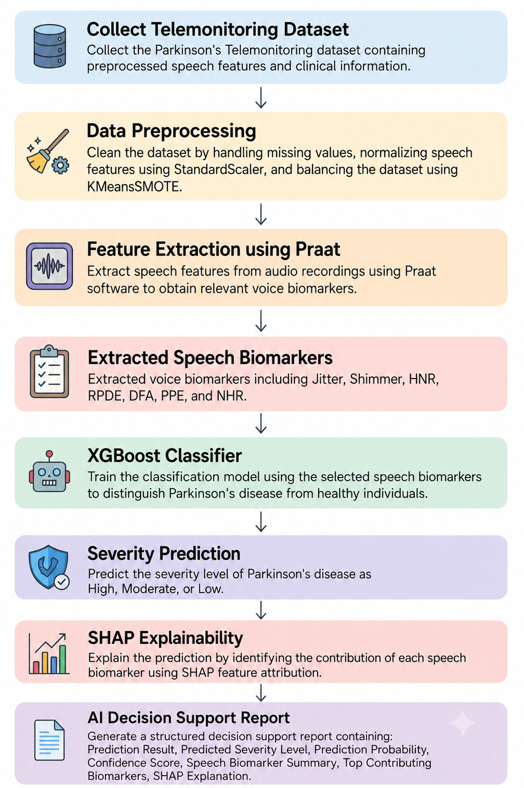
ARCHITECTURE DIAGRAM

Slide 6
PROPOSED WORK WITH PLANNED INNOVATION
PROPOSED WORK
The proposed system predicts Parkinson's disease severity using machine learning and explainable AI.
Step 1 – Collect the Parkinson's Telemonitoring Dataset.
Step 2 - Perform preprocessing by handling missing values, removing duplicates.
Step 3 - Select the most important clinical voice features Praat Feature Selection.
Step 4 - Train the XGBoost model using selected features.
Step 5 - Predict disease severity based on Motor UPDRS or Total UPDRS score.
Step 6 - Use SHAP Explainable AI to identify which features contributed most to the prediction.
Step 7 - Generate AI Decision Support Report

Slide 7

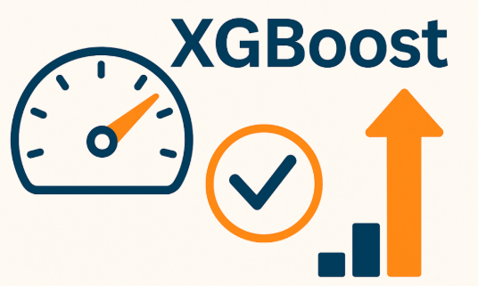
PLANNED INNOVATION
Our project introduces several improvements over existing work.
Predicts Parkinson's severity instead of only detecting disease.
Uses XGBoost Feature Importance with Recursive Feature Elimination.
Reduces redundant clinical features.
Uses SHAP Explainable AI for transparent clinical decision support.
Faster prediction with improved accuracy.
Helps doctors monitor disease progression remotely.
Can be integrated into telemedicine systems for continuous patient monitoring.

Slide 8
MODULES OF THE PROJECT
Dataset Collection Module
Data Preprocessing Module
Feature Selection Module
Severity Prediction Module
Model Evaluation Module
Explainable AI Module
Result Visualization Module

Slide 9
THANK YOU!

